Slide 1
Hohensalzburg Fortress

Slide 2
National Opera and Ballet of Belarus

Slide 3
Historic Center of Bruges

Slide 4
Sofia Land

Slide 5
Prague Orloj

Slide 6
Little Mermaid Statue

Slide 13
Historic Center of Tallinn

Slide 14
Finlandia Hall

Slide 15
Eiffel Tower

Slide 16
Schloss Neuschwanstein

Slide 17
The Acropolis

Slide 18
Buda Castle

Slide 25
The Colosseum

Slide 26
Riga Motor Museum

Slide 27
Historic Center of Vilnius

Slide 28
Grand Ducal Palace

Slide 29
Chișinău Nativity Cathedral

Slide 30
Van Gogh Museum

Slide 37
Oslofjord

Slide 38
Wieliczka Salt Mine

Slide 39
Torre Vasco da Gama

Slide 40
The Danube Delta

Slide 41
The Kremlin

Slide 42
Nikola Tesla Museum

Slide 43
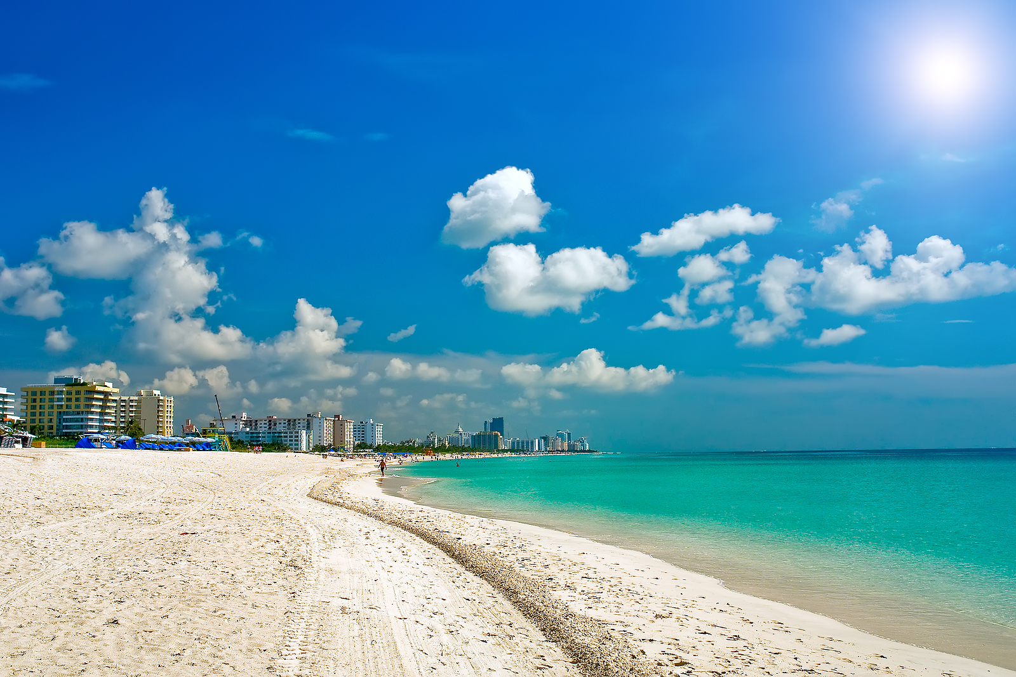

Slide 49
Bratislavský Hrad

Slide 50
Sagrada Familia

Slide 51
Nobel Museum

Slide 52
Large Hadron Collider

Slide 53
Chernobyl

Slide 54
Big Ben

